Slide 1


WEATHER TREND FORECASTING
Analyzing and Predicting Weather Patterns Using Data Science
Hemanth Yarra
27th, March 2025

Slide 2

ABOUT THE PROJECT
This project aligns with the mission of PM Accelerator, which aims to provide industry-leading tools and education to individuals from all backgrounds, leveling the playing field for future Product Management leaders. By granting aspiring and experienced PMs access to industry leaders, the right PM ecosystem, and AI product management skills, PM Accelerator fosters growth in the field

Slide 3

INTRODUCTION
Problem Statement:
Understanding historical weather trends and forecasting future climate patterns can help in decision-making across industries like agriculture, energy, and disaster management.
Objective:
Analyze historical weather data
Identify trends in temperature, precipitation, and other meteorological factors
Build a predictive model for future weather patterns

Slide 4

DATASET OVERVIEW
Dataset: Global Weather Repository
(Kaggle - https://www.kaggle.com/datasets/nelgiriyewithana/global-weather-repository)
Data Includes:Temperature, Wind, Humidity, Air Quality
Moon Phases, Precipitation, Visibility
Objective: Forecast temperature trends

Slide 5
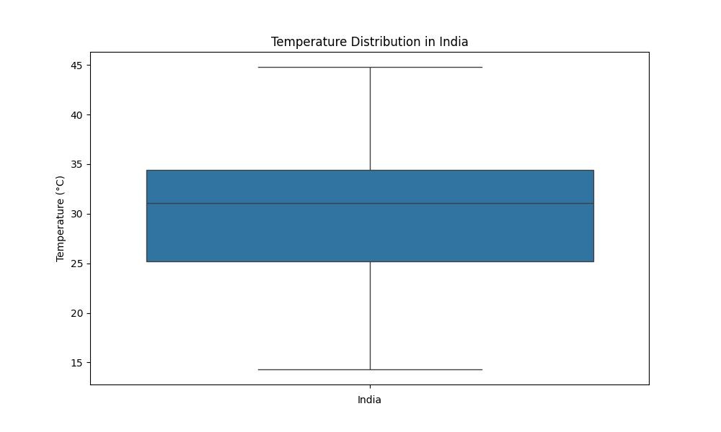
Data PREPROCESSING
Checked for missing values (No missing values found)
Handled categorical variables using Label Encoding
Normalized numerical variables using MinMaxScaler

Slide 6
EXPLORATORY DATA ANALYSIS
Visualizations:
Boxplots for temperature distribution
Histograms for precipitation and humidity
Correlation heatmap
Findings:
Temperature correlates with precipitation and humidity
No significant outliers

Slide 7
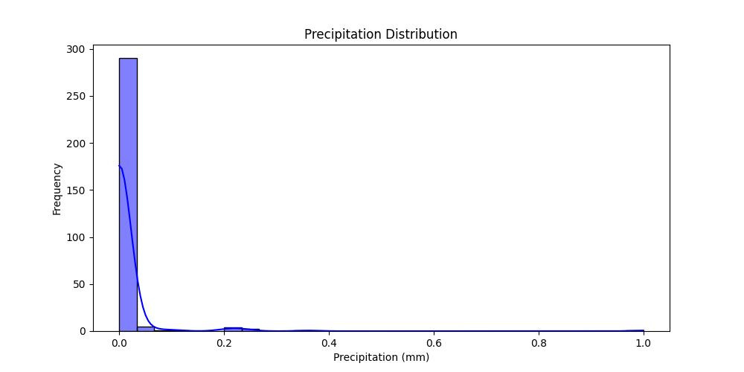

Slide 8
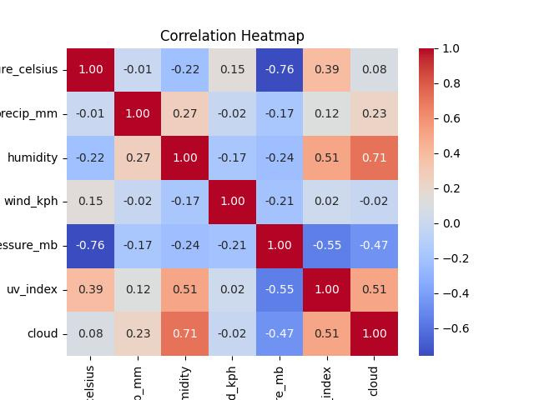

Slide 9

Time Series Analysis
Converted ‘last_updated’ to DateTime format
Plotted Temperature Over Time
Conducted ADF Test for stationarity
Result: p-value = 0.276
Data needed differencing

Slide 10
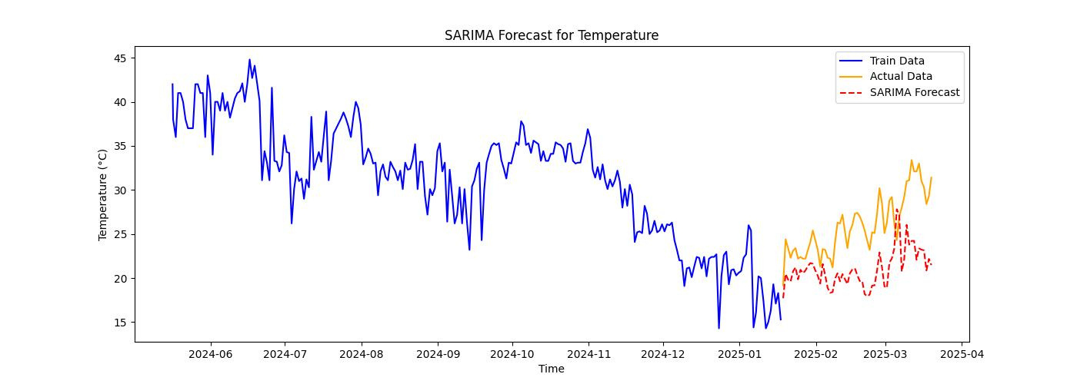
SARIMA MODEL FOR FORECASTING
Parameters:(p=1, d=1, q=1), Seasonal Order: (1,1,1,30)
Explanatory Variables:Wind speed, humidity, precipitation, pressure
Results:Forecasted temperature trends
Visualized train vs. test vs. forecast

Slide 11
SARIMA MODEL EVALUATION
Metrics:MAE (Mean Absolute Error): 3.02
RMSE (Root Mean Squared Error): 12.38
Observations:SARIMA performed well but had some deviations
Prophet was chosen for its ability to capture seasonality and trends without requiring extensive parameter tuning

Slide 12
PROPHET MODEL FOR FORECASTING
Converted Data to Prophet format (ds, y)
Generated 30-day future forecast
Results Saved: weather_forecast.csv
Prophet Model Visualization
Actual vs Forecasted Temperature Plot
Trends & Seasonality:Captured yearly, weekly, and daily variations
Confidence Intervals Displayed
Model Evaluation:
Metrics:MAE (Mean Absolute Error): 2.114
RMSE (Root Mean Squared Error): 2.7
Comparison with SARIMA:
Prophet captures long-term trends better
SARIMA adapts well to short-term fluctuations

Slide 13
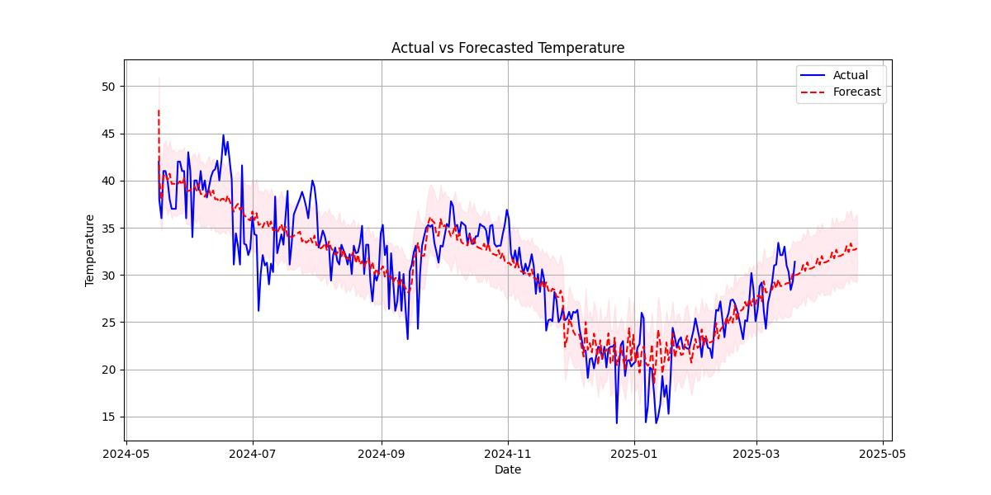

Slide 14
CONCLUSION
SARIMA vs. Prophet: Both models are effective
Key Takeaways:Weather patterns influence temperature variation
Future forecasts help in climate predictions
Next Steps:Extend to multiple countries
Incorporate additional meteorological factors

Slide 15
THANK YOU!

